Slide 1

1T- TaS2 through STM and FFT

Slide 2
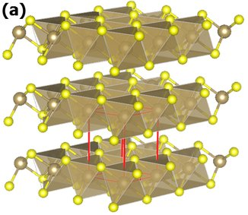
What is 1T-TaS2?
The integer indicates the number of X-T-X sandwiches per unit cell along the hexagonal c axis
T is trigonal symmetries
The 1T phase contains X-T-X sandwiches in which the metal atoms are octahedrally coordinated
Polytypes consist of one or more than three-layer sandwiches, inner layer of metal enclosed by layers of chalcogenide atoms
The layers of the sandwiches arranged in hexagonal closed-packed planes
Figure 1: Crystal structure of 1T-TaS2. The hexagonal unit-cell is represented in red. Adapted from ”. “Watching the birth of a charge density wave order: diffraction study on nanometer-and picosecond-scales”. https://www.researchgate.net/publication/315515510_Watching_the_birth_of_a_charge_density_wave_order_diffraction_study_on_nanometer-and_picosecond-scales/figures?lo=1

Slide 3
Phases in 1T-TaS2
Nearly Commensurate phase (NC Phase):
the CDW is at an average angle which causes it to be incommensurate with the underlying atomic lattice
Angle varies with temperature, changing from 11° to 13°
Incommensurate phase (I Phase):
The CDW is aligned with the lattice, although the CDW wavevector is incommensurate
Wavelength 3.53 a₀ (a₀ is the lattice constant of 3.346 Å)
Commensurate phase (C Phase): the CDW is completely commensurate with the underlying tantalum lattice
Wavelength 3.606 a₀
Triclinic phase (T Phase)
CDW loses its hexagonal symmetry
The domains are very long and narrow, providing a larger number of CDW maxima (or minima)

Slide 4
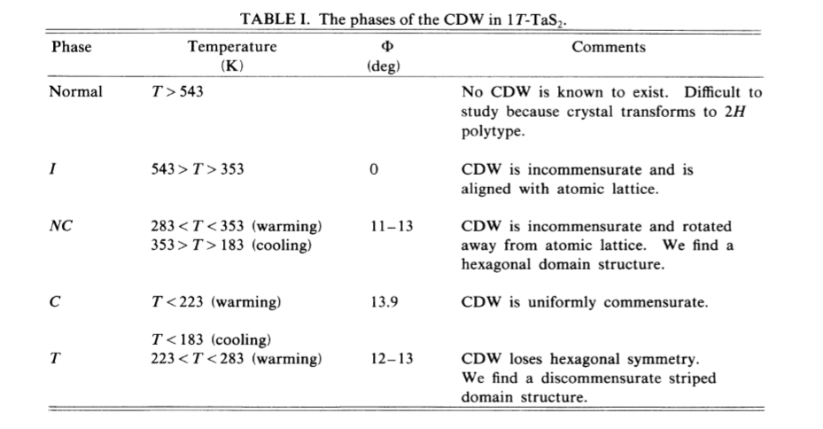
Figure 2: Thomson, R.E, B. Burk, A. Zettl, John Clarke. “Scanning tunneling microscopy of the charge-density-wave structures in 1T-TaS2”

Slide 5
Data Categorization

Slide 6
CDW and lattice peaks

Slide 7
CDW and domain peaks
At room temperature
(*) Harder to find domain in Cooling down process

Slide 8
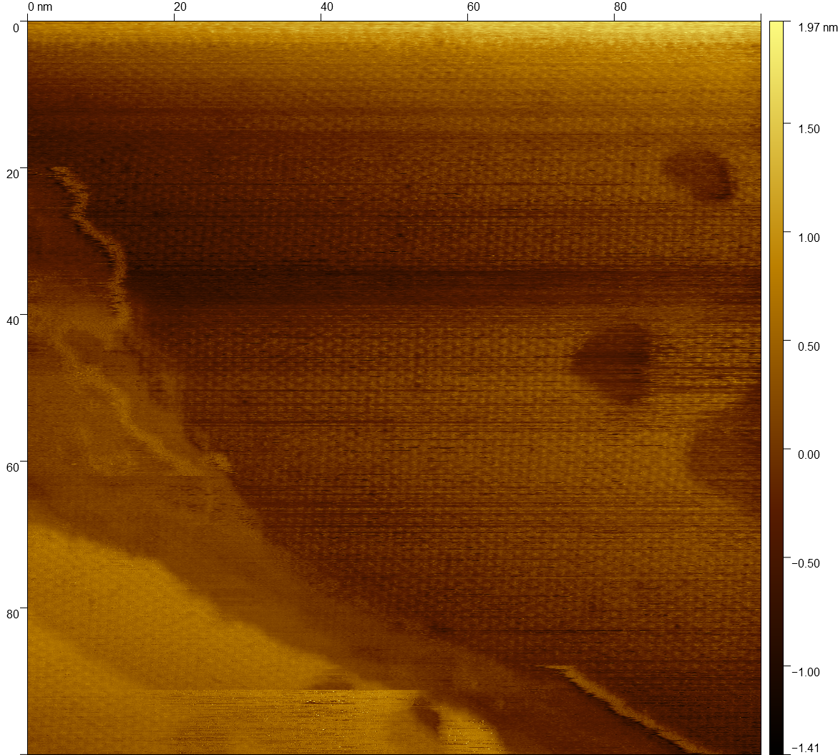
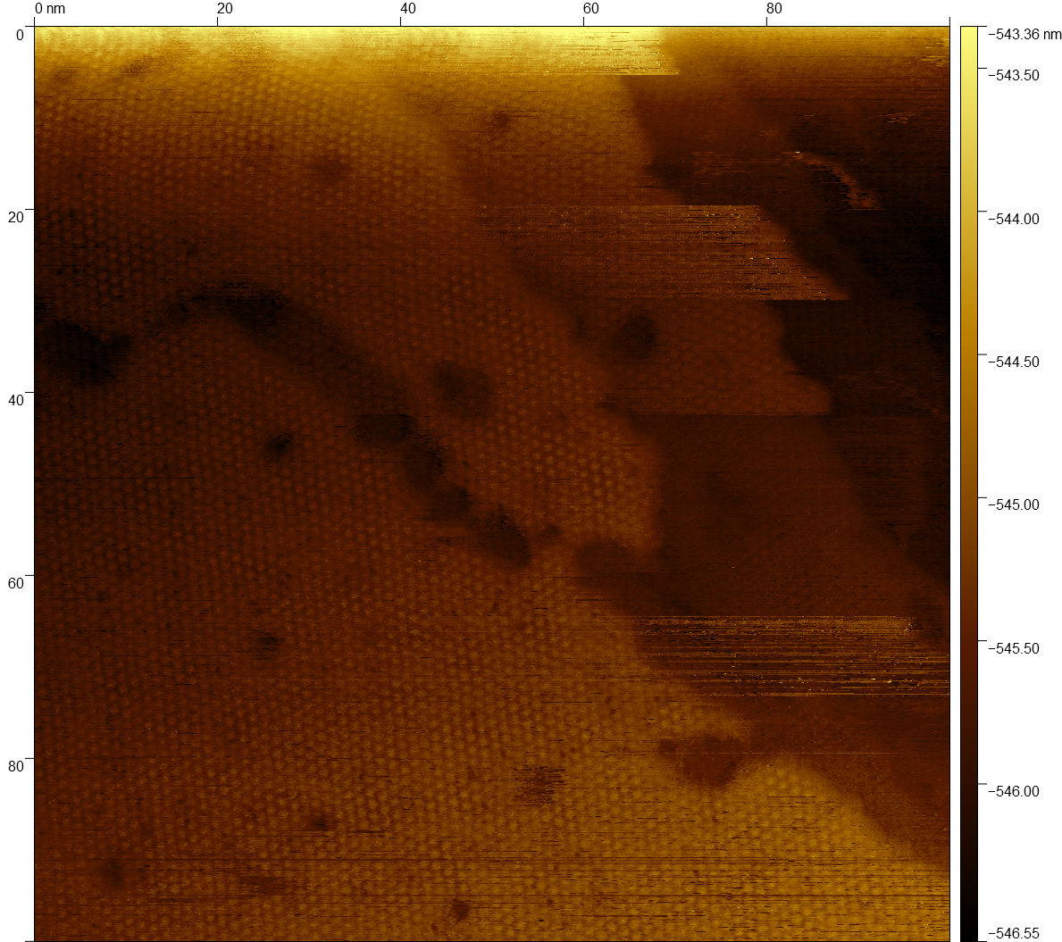
Interesting Data Points
#6120: topography
#6122: topography

Slide 9
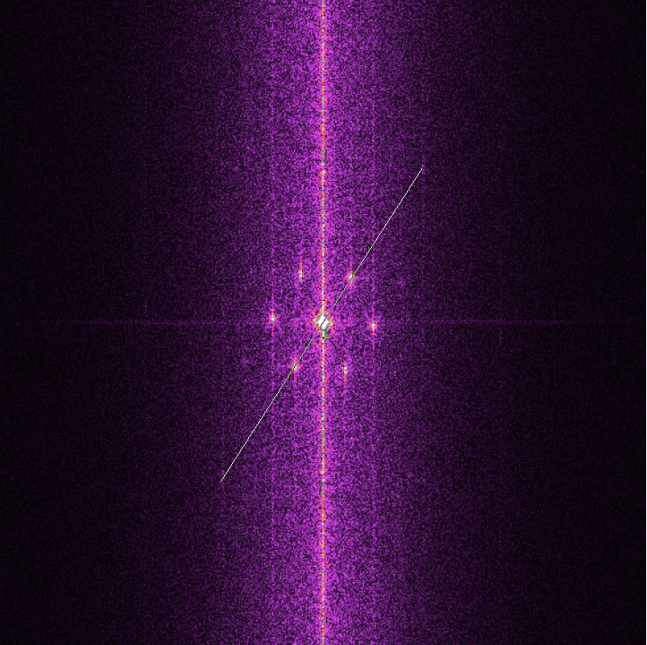
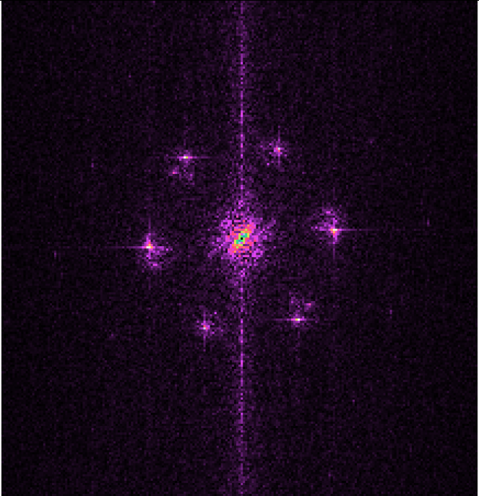
Interesting Data Points
#6120: FFT
#6122: FFT

Slide 10
Interesting Phase Change
Warming Up
4751 - 4781: NC Phase (357.5K)
4782 - 5145: IC Phase (359.30K)
5146 - 5303: NC Phase (359.14K)
5304 – 5591: IC Phase (359.30K)
5311 and 5312: IC Phase
Cooling Down
5591 – 6032: IC Phase (359.30K)
6033 – 6107: IC Phase (356.61K)
6125 – 6201: NC Phase (356.2K)
(*) There are images that do not have a good indication of what phase is it (only show CDW).

Slide 11
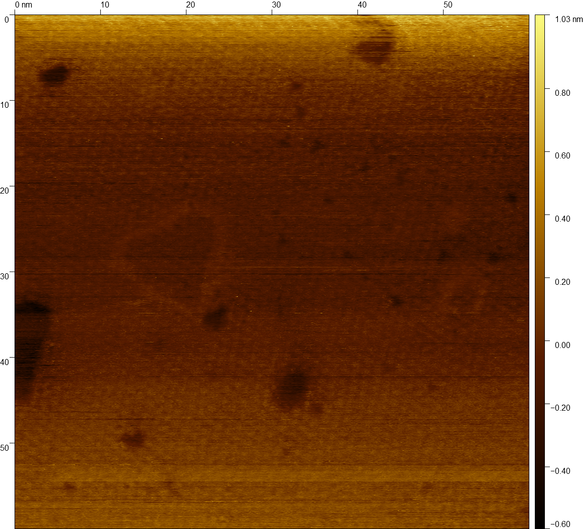
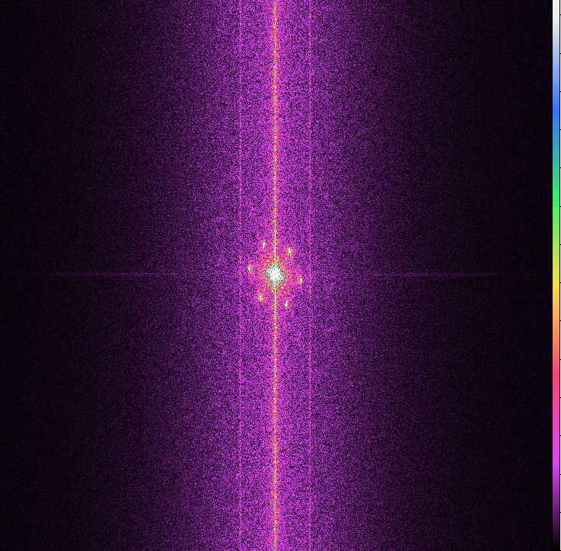
Warming Up
#4789: 359.23K

Slide 12
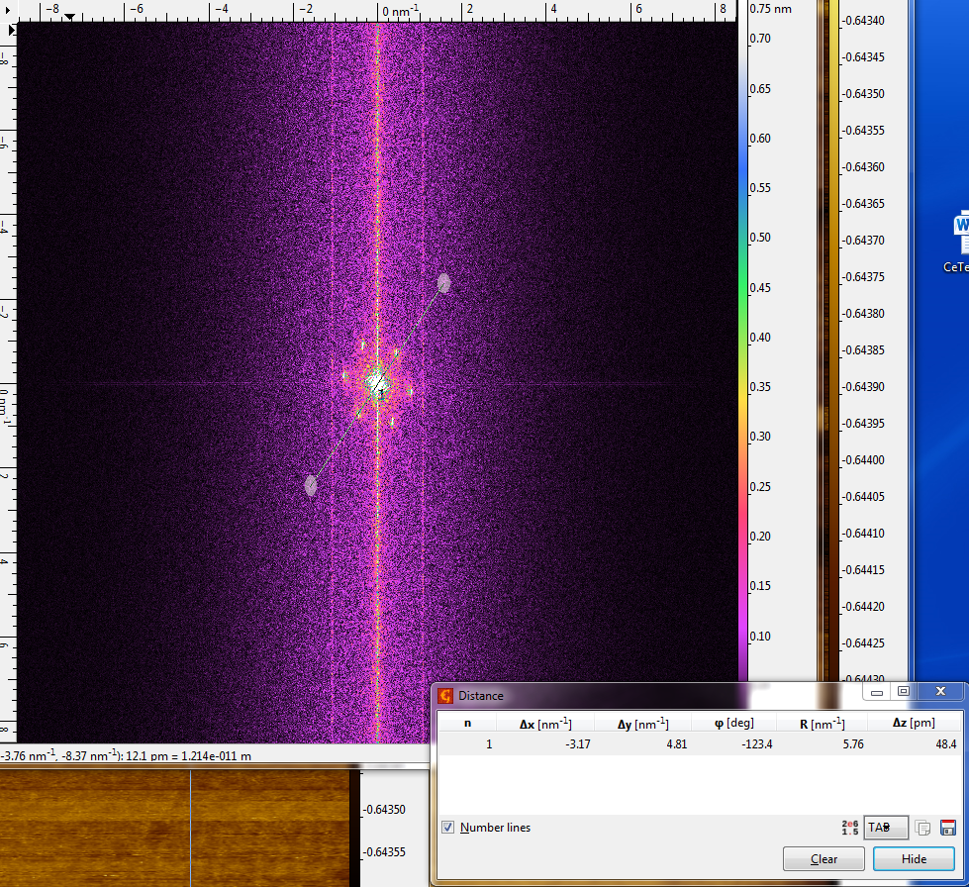

Slide 13
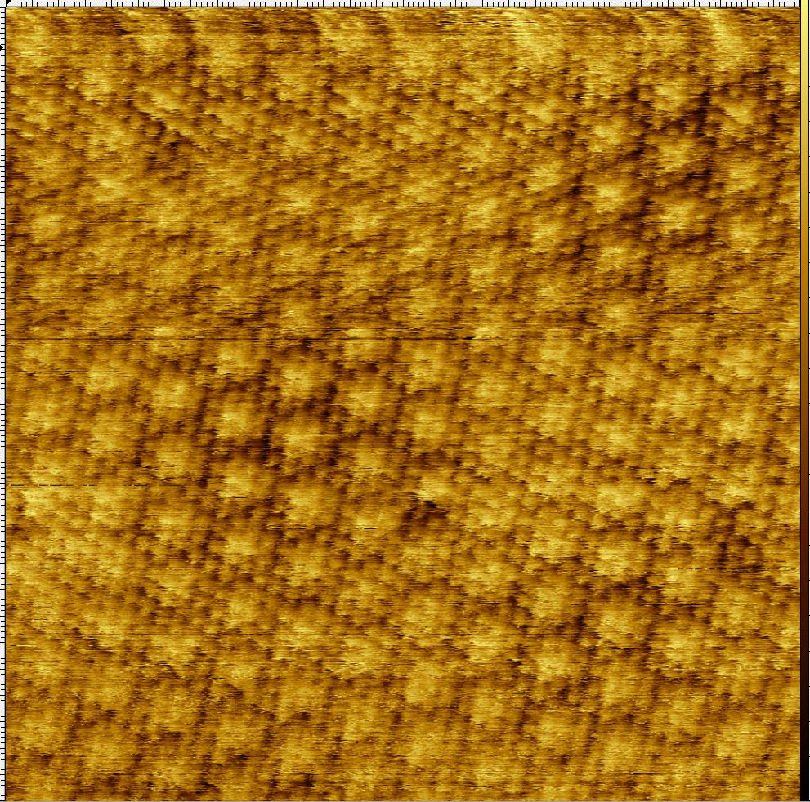
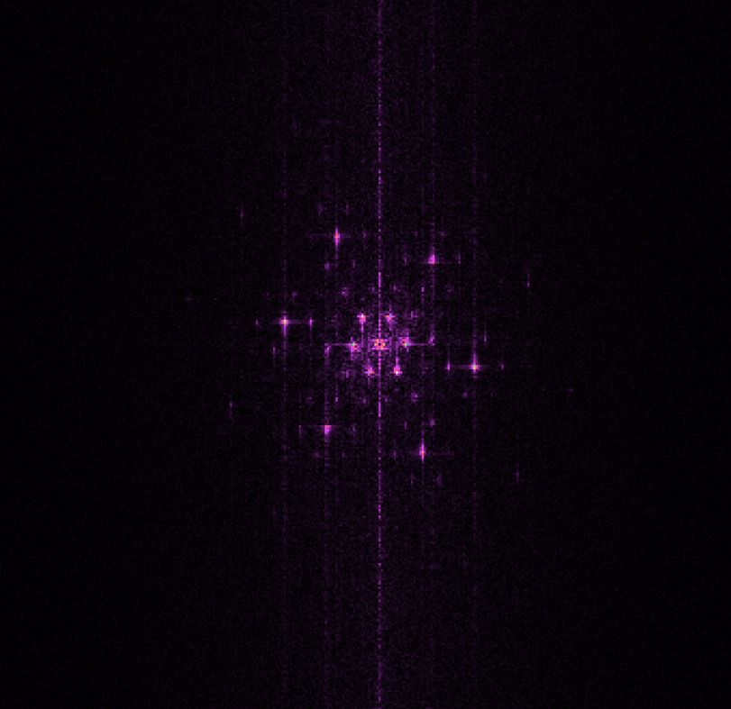
Beauty FFT images
#1403: Room Temp
NC Phase

Slide 14
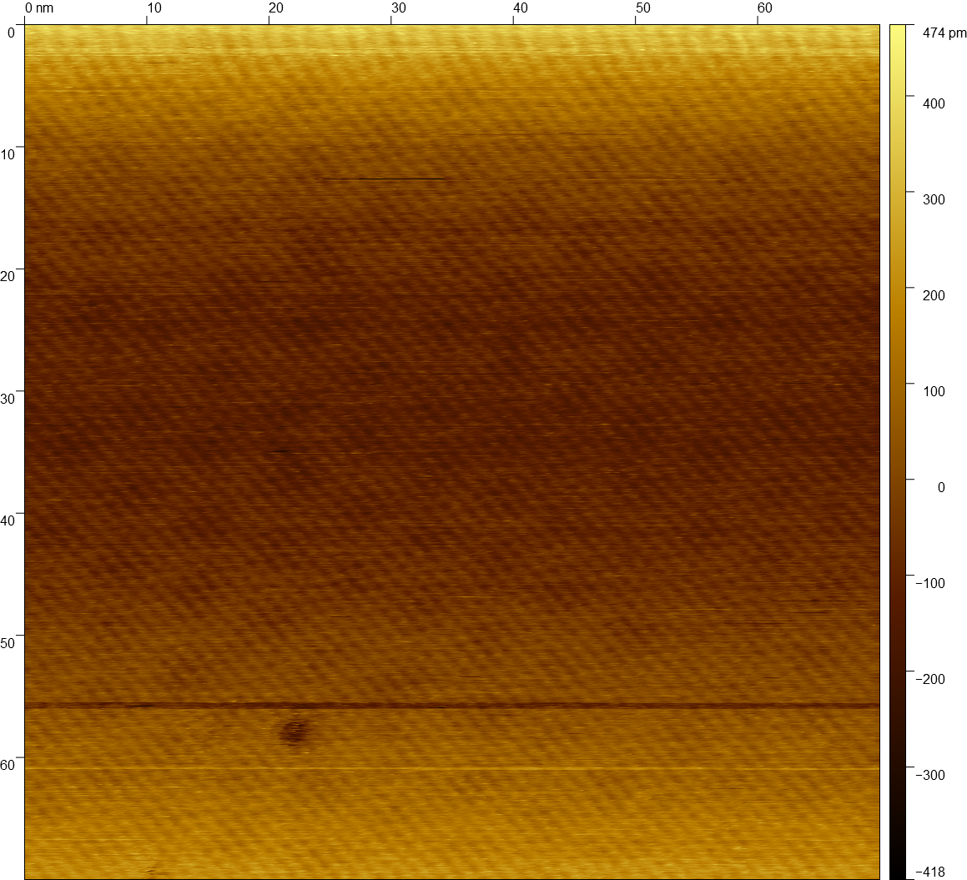
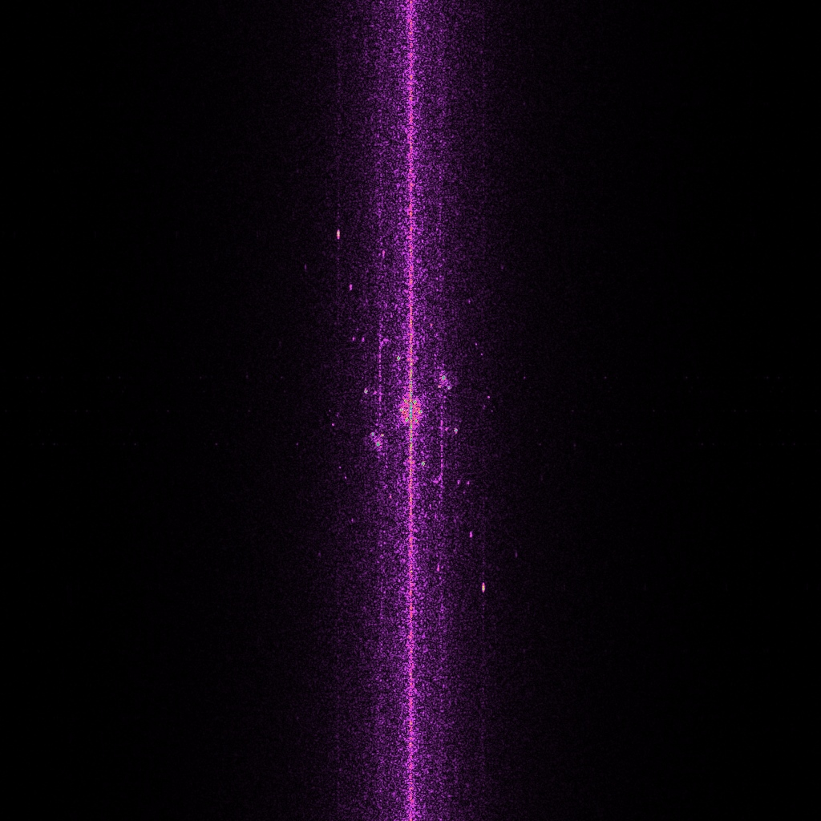
#2509: 356.13 K

Slide 15
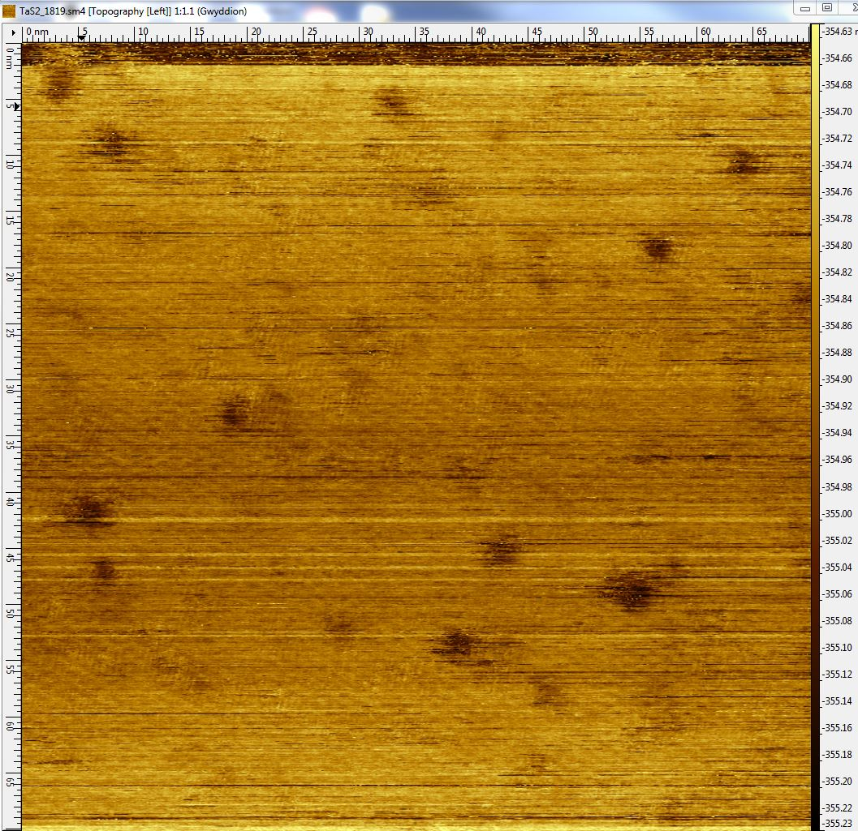
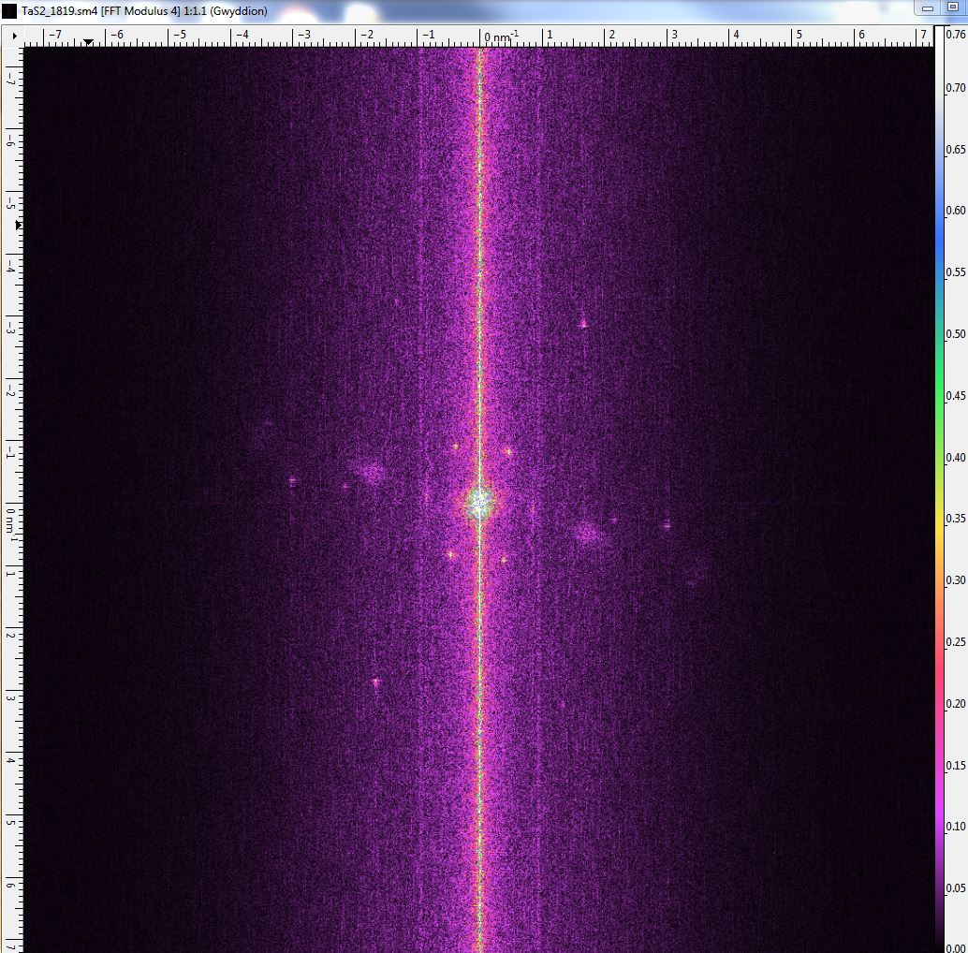
IC Phase
#1819 362.45

Slide 16
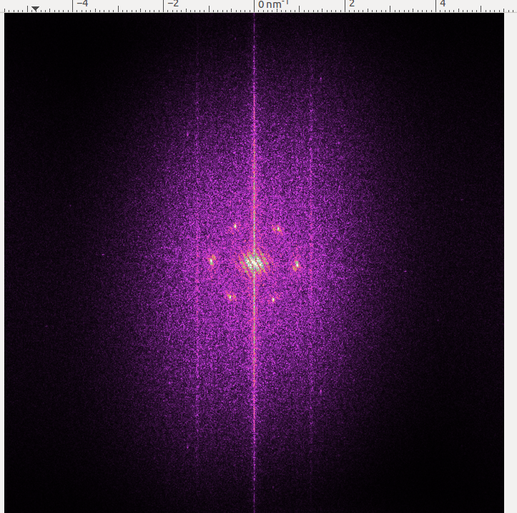
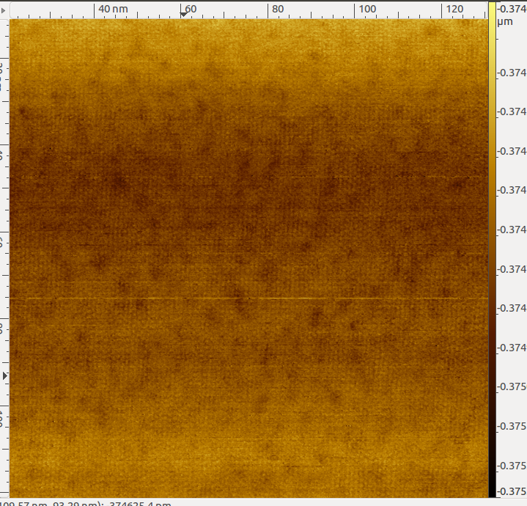
#4311: 356.61K
IC Phase with a hint of domain

Slide 17
Reference List
“Watching the birth of a charge density wave order: diffraction study on nanometer-and picosecond-scales”. Retrieved from https://www.researchgate.net/publication/315515510_Watching_the_birth_of_a_charge_density_wave_order_diffraction_study_on_nanometer-and_picosecond-scales/figures?lo=1
Thomson, R.E, B. Burk, A. Zettl, John Clarke. “Scanning tunneling microscopy of the charge-density-wave structures in 1T-TaS2”

